Slide 1
IoT Platform Design Methodology
Dr.K.Nirmala Devi
Associate Professor/CSE
Kongu Engineering College

Slide 2
Introduction
IoT system comprises of multiple components and deployment tires
IoT consists of 6 levels and each level is suited for different applications and has different component and deployment configurations.
Designing of IoT systems can be a complex and challenging task as these systems involve interactions between various components such as
IoT devices and network resources
Web services
Analytics components
Application and
Database servers

Slide 3
Outline
IoT Design Methodology that includes:
Purpose & Requirements Specification
Process Specification
Domain Model Specification
Information Model Specification
Service Specifications
IoT Level Specification
Functional View Specification
Operational View Specification
Device & Component Integration
Application Development

Slide 4
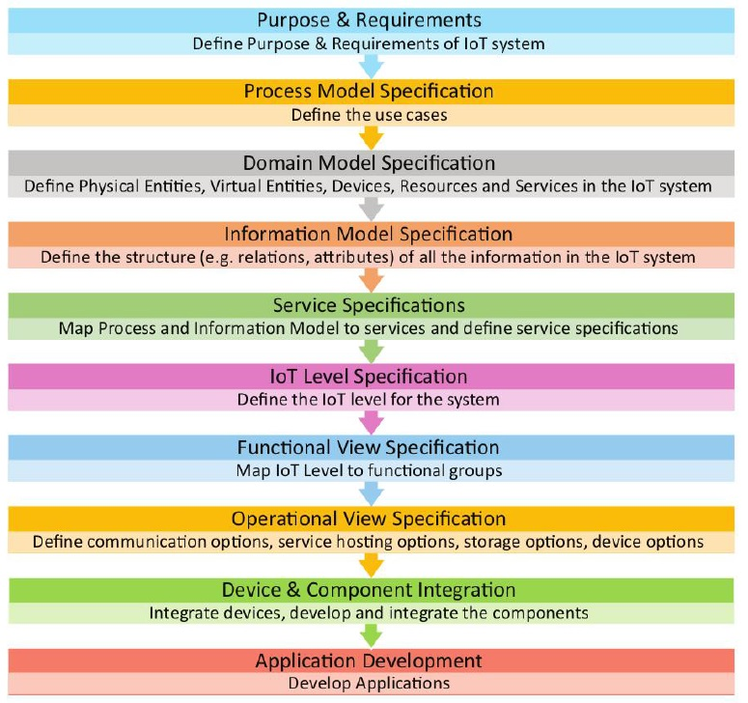
Steps involved in IoT System design methodology

Slide 5
Step 1: Purpose & Requirement Specification
The first step in IoT system design methodology is to define the purpose and requirements of the system.
In this step, the system purpose, behavior and requirements are captured.
Requirements are such as
Data collection requirements
Data analysis requirements
System management requirements
Data privacy and security requirements
User interface requirements

Slide 6
Step 2: Process Specification
The second step in the IoT design methodology is to define the process specification.
In this step, the use cases of the IoT system are formally described based on and derived from the purpose and requirement specifications.

Slide 7
Step 3: Domain Model Specification
The third step in the IoT design methodology is to define the Domain Model.
The domain model describes the main concepts, entities and objects in the domain of IoT system to be designed.
Domain model defines the attributes of the objects and relationships between objects.
Domain model provides an abstract representation of the concepts, objects and entities in the IoT domain, independent of any specific technology or platform.
With the domain model, the IoT system designers can get an understanding of the IoT domain for which the system is to be designed.

Slide 8
Step 4: Information Model Specification
The fourth step in the IoT design methodology is to define the Information Model.
Information Model defines the structure of all the information in the IoT system, for example, attributes of Virtual Entities, relations, etc.
Information model does not describe the specifics of how the information is represented or stored.
To define the information model, we first list the Virtual Entities defined in the Domain Model.
Information model adds more details to the Virtual Entities by defining their attributes and relations.

Slide 9
Step 5: Service Specifications
The fifth step in the IoT design methodology is to define the service specifications.
Service specifications define the
Services in the IoT system
Service types
Service inputs/output
Service endpoints
Service schedules
Service preconditions and
Service effects.

Slide 10
Step 6: IoT Level Specification
The sixth step in the IoT design methodology is to define the IoT level for the system.
In Unit-1, we defined six IoT deployment levels.

Slide 11
Step 7: Functional View Specification
The seventh step in the IoT design methodology is to define the Functional View.
The Functional View (FV) defines the functions of the IoT systems grouped into various Functional Groups (FGs).
Each Functional Group either provides functionalities for interacting with instances of concepts defined in the Domain Model or provides information related to these concepts.

Slide 12
Step 8: Operational View Specification
The eighth step in the IoT design methodology is to define the Operational View Specifications.
In this step, various options pertaining to the IoT system deployment and operation are defined, such as,
Service hosting options
Storage options
Device options
Application hosting options, etc

Slide 13
Step 9: Device & Component Integration
The ninth step in the IoT design methodology is the integration of the devices and components.

Slide 14
Step 10: Application Development
The final step in the IoT design methodology is to develop the IoT application.

